Slide 1


Pre Alexandra Calmy, Geneva University Hospitals
Scientific highlights
IAS 2025 (Kigali, Rwanda)
Cure, antiretroviral strategies, implementation science and more.
Geneva, September 3rd, 2025, IAS Webinar
WE WILL NOT GO BACK!
ias2025.org
Notes:
Dear colleagues, thank you for giving me the opportunity to present the key scientific highlights of IAS 2025, which took place in Kigali, Rwanda
The Odyssey children study
The OAA 0202
The LB48
The OAA 506 LB
Although the IAS knowledge toolkits summarizing conference highlights will not be ready in time for the webinar, I am happy to share the topics IAS has identified for the toolkits. We hope this can be a helpful guide in the preparation of your presentation:
PrEP
WHO Lenacapavir guidance (SAT11, Michelle Rodolph presentation)
MK-8527 (OAS0106LB)
LA-CAB real-world implementation (LB48)
ART and co-morbidities
IMPALA Cab/RPV adherence challenges (OAS0105LB)
Intermittent therapy (OAB0106LB,OAS0104LB)
MODERATO dual therapy West and Central Africa (OAB0103)
Weight gain (OAB0204,OAB0206LB)
UNITY tecovirimat for mpox (OAM01)
Strides and setbacks in paediatric and adolescent care
ODYSSEY trial and predicators of treatment failure in children
Early administration of two bNAbs in infants
Inflammation in children (OAA0103,OAA0502)
Basic science and the reservoir
Xu Yu plenary (PL01 – Understanding the HIV reservoir)
bnABs + immune modulator (OAA0202)
AGT103-T (OAA0506LB)
The page on our websitesummarizing the key takeawaysof the conference, as well as therapporteur summaries, may also be helpful.

Slide 2

Content
From track A to track D: a personalized pathway!
Cure and Prevention – HIV in the corner
ART strategies
Co-morbidities
Conclusions and Take-home messages
13 – 17 July • Kigali, Rwanda
ias2025.org
Notes:
I will talk about cure, prevention, antiretroviral strategies, comorbidities, and then highlight the main perspectives from track A and track B, in order to cover the full range of thematic axes: basic science, clinical science, epidemiology, social and behavioral sciences, implementation, economics, and health systems. Of course, this is a subjective journey, but one that I hope will be both generalizable and of interest to this friendly audience.

Slide 3
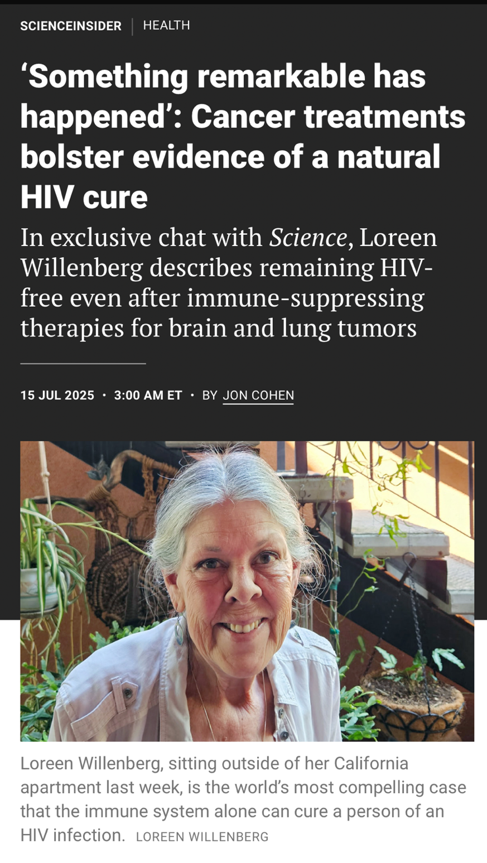
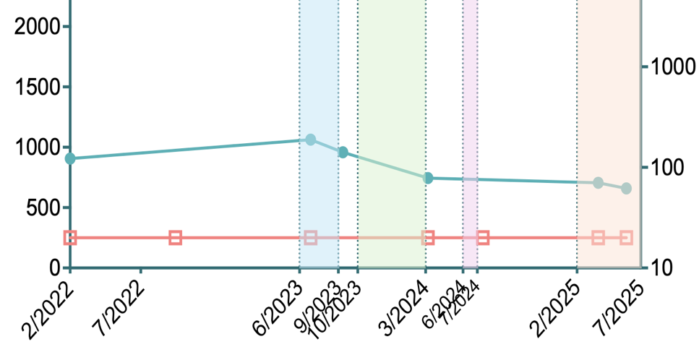
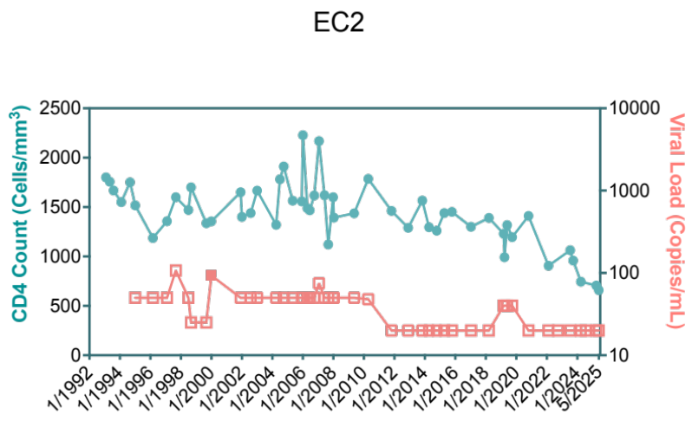



Loreen Willenberg further evidence of natural HIV cure?
Diagnosis of lung cancer
Pembrolizumab
Carboplatin/Pemetrexed/Pembrolizumab
Sotorasib
Adagrasib
HIV copies/ml
Undetectable VL
CD4+ T-cell count
Notes:
The conference began with good news, with the remarkable case of Lorène Wilhenberg. She has maintained an undetectable viral load for many years without antiretrovirals, and even the diagnosis of lung cancer and associated treatments did not compromise viral control. Mrs. Wilhenberg belongs to the rare group of so-called elite controllers, who provide unique insights into immune strategies for long-term HIV control.
Loreen Willenberg’s case, highlighted at IAS 2025, is remarkable because she has maintained undetectable HIV levels for more than three decades without ever receiving antiretroviral therapy. Despite extensive testing, no intact virus has been detected in her body, suggesting a form of functional cure. Importantly, her immune control of HIV was not affected even when she developed and overcame lung cancer. As one of the very few “elite controllers,” her case offers crucial insights into immune-based strategies for long-term HIV remission and potential cure

Slide 4

CAR-T cell-secreted bNAbs
mediate Fc-effector functions and reduce viral load in humanized mouse model of HIV infection
Fonctions effectrices des CAR-T sécrétant des bNAbs et réduction de la charge virale dans un modèle murin humanisé du VIH
Z.Stylianidou¹ , S. Gerlo¹ , M. Wejda¹ , E. Burg¹ , E. De Smet¹ , Y. Noppe¹ , L. Vandekerckhove¹, W. Witkowski¹ ¹HIV Cure Research Center, Ghent University, Faculty of Medicine and Health Sciences, Ghent, Belgium
Can Hybrid CAR-T cells contribute to a functional cure?
Notes:
I chose to present, in basic science, an abstract highlighting the potential of CAR-T cells. Their effector functions could secrete broadly neutralizing antibodies (bNAbs) to reduce viral load in a humanized mouse model of HIV, as demonstrated in this presentation.

Slide 5
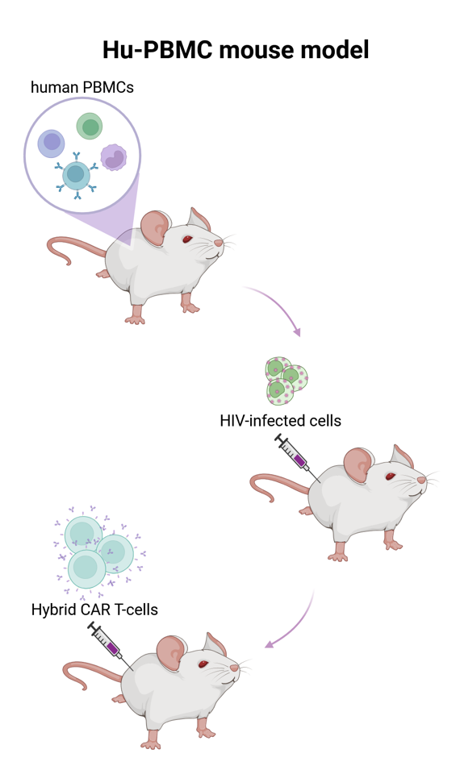
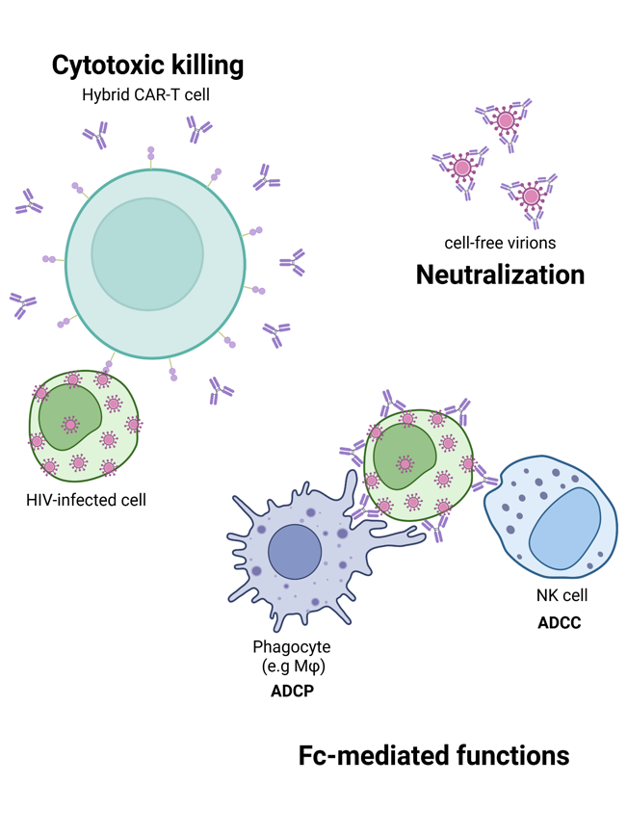
Hybrid CAR-T cells represent a promising avenue toward a functional cure for HIV
Secretion of 3BNC117 (broadly neutralizing antibody) by hybrid CAR-T cells and HIV neutralization
Secreted 3BNC117 induces Fc-dependent effector functions
In vivo efficacy: elimination of infected cells and detection of 3BNC117 in the plasma of humanized mice
Zoe Stylianidou • 15/07/2024
Notes:
The investigators showed that these CAR-T cells were able to secrete broadly neutralizing antibodies, whose efficacy allowed the elimination of infected cells. Moreover, these neutralizing antibodies were even detected in the plasma of the humanized mice.Thus, CAR-T cells appear to be a promising avenue in the search for a functional cure for HIV.
CAR-T cells engineered to secrete bNAbs reduced viral load in a humanized mouse model and mediate Fc-effector functions
Hybrid CAR-T cells represent a promising avenue toward a functional cure for HIV, but their success will depend on their ability to control latent viral reservoirs and to maintain durable activity in the body.

Slide 6
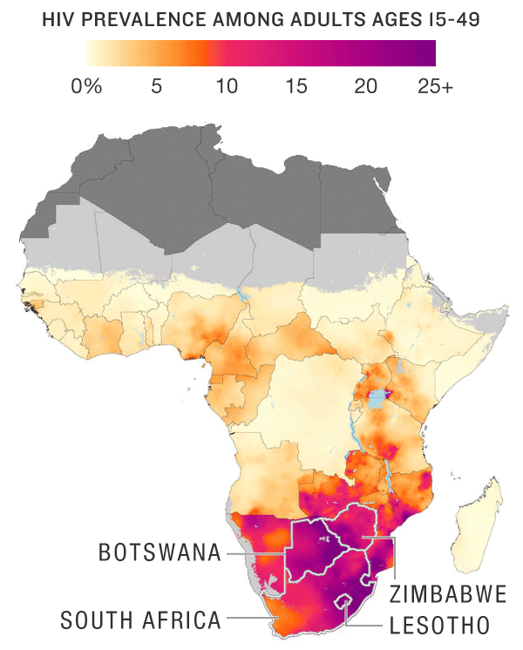
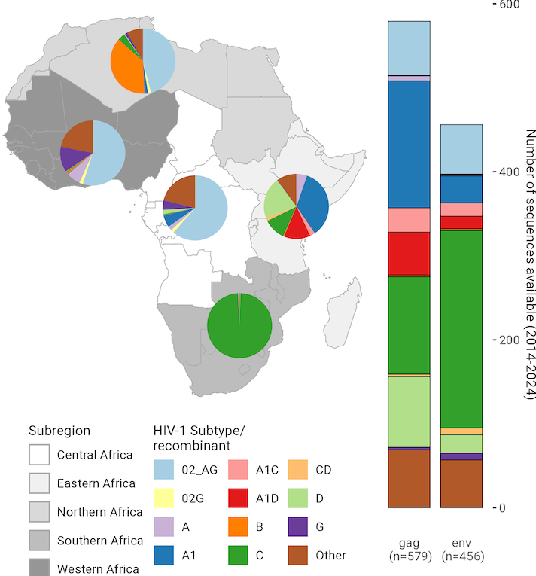
Vaccine science – Dr. Penny Moore (plenary)
Gaps in key knowledge:
  HIV sequence diversity
  Host genetic diversity
AMP* (antibody mediated prevention) study – demonstrated proof of concept that an antibody vaccine could prevent HIV acquisition
Early life administration of 2 bNAbs as safe in infants, supporting further investigation into antibody-based strategies to prevent vertical transmission.
HIV Prevalence
HIV sequence coverage
Notes:
Today, if we talk about ending HIV aside from cure, vaccines remain a critical topic not to be overlooked.Many unknowns still exist in the knowledge needed to achieve an effective vaccine. First, HIV sequence diversity is well known, but host genetic diversity is also significant, and both must be taken into account when designing a vaccine. Proof-of-concept studies have already demonstrated that antibody-based vaccines could prevent HIV acquisition. In addition, very interestingly, administration of broadly neutralizing antibodies to infants could also be an important strategy to prevent vertical transmission of the virus from mother to child.
Why is this information important? Broadly neutralizing antibodies are increasingly central to HIV research, including immunotherapy, cure research, and vaccine development.
Broadly neutralizing antibodies (bNAbs) have a steadily growing role in HIV research, driven by insights from immunotherapy, cure science and vaccine developmentEarly-life administration of two bNAbs (CAP256V2LS and VRC07-523LS) was safe in infants, supporting further investigation into antibody-based strategies to prevent vertical transmission. AMP Study – Antibody Mediated Prevention
Objective: Test whether the broadly neutralizing antibody (bNAb) VRC01 could prevent HIV infection.
Design: Two Phase 2b trials (HVTN 704/HPTN 085 in the Americas; HVTN 703/HPTN 081 in Africa).
Population: >4,600 participants at risk of HIV.
Results (2021):
No overall protection against HIV.
Efficacy only against VRC01-sensitive strains (~30% of circulating viruses).
Significance:
First proof-of-concept that bNAbs can prevent HIV.
Opened the path for next-generation bNAbs and antibody combinations for prevention.

Slide 7
Why is this important?
Broadly neutralizing antibodies (bNAbs) have a steadily growing role in HIV research, driven by insights from immunotherapy, cure science and vaccine development
Notes:
Why it this important
Broadly neutralizing antibodies (bNAbs) have a steadily growing role in HIV research, driven by insights from immunotherapy, cure science and vaccine development

Slide 8
Multifaceted prevention
Notes:
Prevention is multifaceted, and I will now focus my presentation on clinical trials of pre-exposure prophylaxis (PrEP).
36. One might ask whether it’s still wise to pursue the seemingly endless quest for an HIV vaccine in an era where lenacapavir offers twice-yearly—and potentially once-yearly—pre-exposure prophylaxis. But that, in itself, could be the subject of an entire conference. But you might have an idea to answer this question?

Slide 9
PURPOSE 1 and PURPOSE 2 Results in Adolescents and Young Adults: Study Designs
PURPOSE-1
Centralized 2:2:1
LEN* SC (927 mg) Q26W +
FTC/TAF or FTC/TDF placebo PO QD x 52 wk
(n = 2134)
Cisgender women aged 16-25 yr; sexually active with cisgender men and >1 vaginal intercourse within last 3 mo (not pregnant); unknown HIV status;
no prior HIV testing or PrEP/PEP use in last 3 mo; ≥35 kg body weight;
eGFR ≥60 mL/min
(N = 5338)
FTC/TAF (200 mg/25 mg) PO QD +
LEN placebo SC Q26W x 52 wk
(n = 2136)
FTC/TDF (200 mg/300 mg) PO QD +
LEN placebo SC Q26W x 52 wk
(n = 1068)
PURPOSE-2
Cisgender men, transgender women, transgender men, and gender nonbinary people with unknown HIV status; aged ≥16 yr; sexually active with ≥1 partner who is assigned male sex at birth within last 12 mo and 1 risk factor†; no prior HIV testing or oral PrEP/PEP use in last 3 mo; no prior LA PrEP use
(N = 3295)
LEN 600 mg PO
on D1, D2
(n = 2179)
LEN‡ 927 mg SC Q26W
FTC/TDF (200/300 mg) PO QD
(n = 1086)
Gill. IAS 2025. Abstr OAC0503.
Notes:
The PURPOSE 1 and PURPOSE 2 studies presented results in adolescents and young adults. This slide shows the study design: PURPOSE 1 focused mainly on cisgender women, while PURPOSE 2 included cisgender men, transgender women, transgender men, and non-binary people.
eGFR, estimated glomerular filtration rate; F, emtricitabine; LEN, lenacapavir; PrEP, pre-exposure prophylaxis; SC, subcutaneous; TAF, tenofovir alafenamide; TDF, tenofovir disoproxil fumarate.

Slide 10
PURPOSE 1 and PURPOSE 2 Results in Adolescents and Young Adults: HIV Infections
Gill. IAS 2025. Abstr OAC0503. Reproduced with permission.
PURPOSE-1 (16-25 Yrs)
PURPOSE-2 (≥16 Yrs)
4
4
2.37
2.41
3
2.02
1.69
3
2
2
0.93
HIV Incidence Per 100 PY (95% CI)
HIV Incidence Per 100 PY (95% CI)
1
1
0.10
0
0
0
Background HIV Incidence
LEN
0 Infections
1939 PY
F/TAF
39 Infections
1932 PY
F/TDF
16 Infections
949 PY
Background HIV Incidence
LEN
2 Infections
1938 PY
F/TDF
9 Infections
967 PY
Injection-site reactions in youth were predominantly mild and aligned with those reported in the broader PURPOSE 1 and 2 study populations. In the PURPOSE 1 and PURPOSE 2 studies, LEN efficacy and safety in adolescents and young adults were similar to those seen in adults
Notes:
The results are shown here, and we recall the emotion caused by PURPOSE 1 results in Munich, which demonstrated zero infections among young women who received lenacapavir twice yearly. In both studies, lenacapavir’s efficacy and safety in adolescents and young adults were found to be identical to what had been observed in the overall adult study population.
In the PURPOSE 1 and PURPOSE 2 studies, LEN efficacy and safety in adolescents and young adults were similar to those seen in adults
CI, confidence interval; F, emtricitabine; LEN, lenacapavir; TAF, tenofovir alafenamide; TDF, tenofovir disoproxil fumarate.
ªOverall n: background HIV incidence group, 8094; LEN, 2134; F/TAF, 2136; F/TDF, 1068. ^{b}95% CIs: background HIV incidence group, 1.82-3.19; LEN, 0-0.19; F/TAF, 1.44-2.76; F/TDF, 0.96-2.74. ^{c}Overall n: background HIV incidence group, 4634; LEN, 2179; F/TDF, 1086. ^{d}95% CIs: background HIV incidence group, 1.65-3.42; LEN, 0.01-0.37; F/TDF, 0.43-1.77.
/l,k;lk;lk

Slide 11
Why is this important?
Phase 3 Purpose 1 and 2 trial data showed that LEN was efficacious and well tolerated among a broad range of populations, including pregnant and lactating women and adolescents and young people.
Lenacapavir was efficacious, safe, and well tolerated, with minimal exposure in breastfed infants (OAC0504).
13 – 17 July • Kigali, Rwanda
ias2025.org
Notes:
Why is this important?
Phase 3 data from PURPOSE 1 and 2 showed that lenacapavir is effective and well tolerated in diverse populations, including pregnant and breastfeeding women, adolescents, and young adults. In addition, lenacapavir showed a favorable safety and tolerability profile, with minimal exposure in breastfed infants. The Phase 3 trials confirmed lenacapavir’s efficacy and safety in these diverse populations, marking an important step forward.

Slide 12
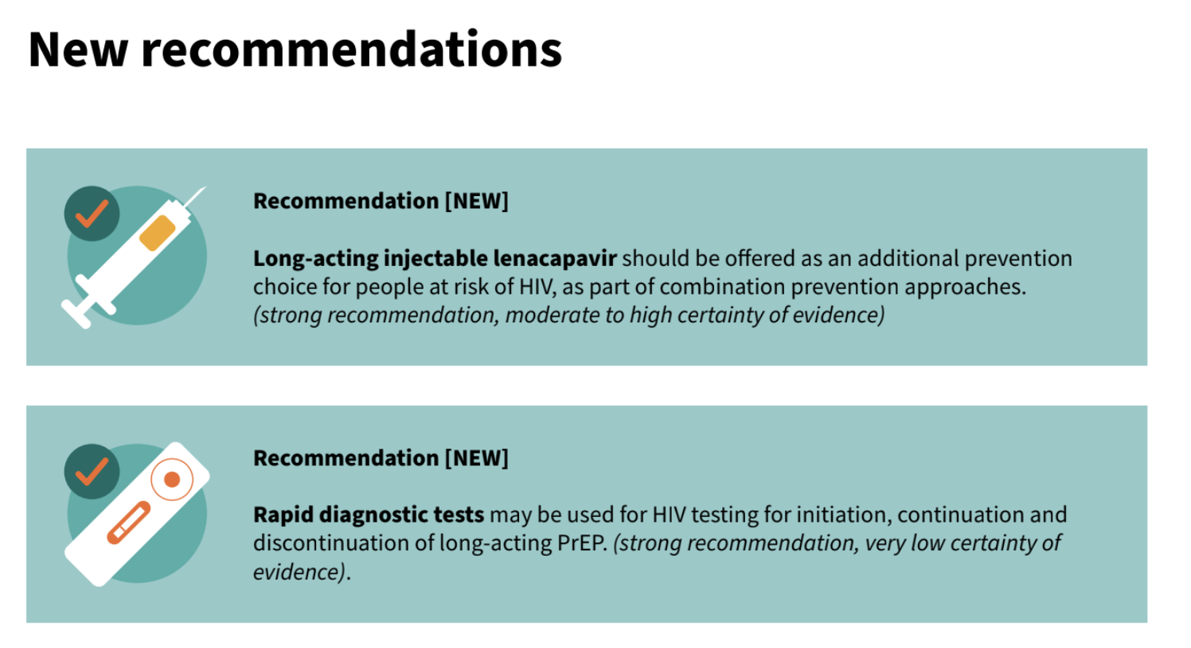
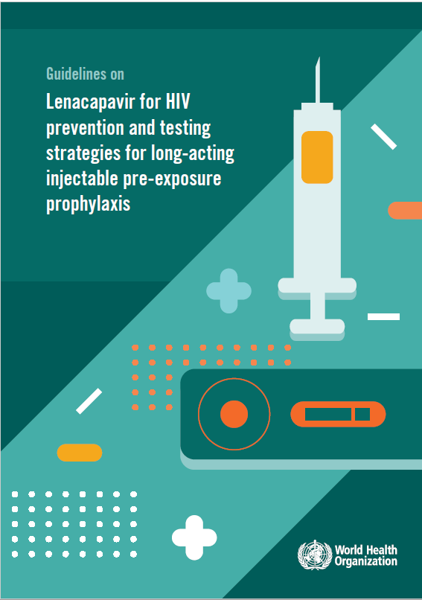
WHO Guidelines on lenacapavir for HIV prevention and testing strategies for long-acting injectable PrEP
Notes:
These studies led WHO to update its recommendations on pre-exposure prophylaxis, now endorsing lenacapavir for HIV prevention.
They also revised testing guidelines for initiating, continuing, and discontinuing long-acting PrEP.
This change is critical — a real pivot in HIV prevention — and was certainly one of the major moments of the IAS conference.

Slide 13
Safety and Pharmacokinetics of MK-8527 Oral Once-monthly: a Phase 2 Study in Adults at Low Risk of HIV-1 Exposure
Oral presentation OAS0106LB - The growing toolbox of long-acting options
Kenneth Mayer^{1,2}, et al ¹Fenway Health and Department of Medicine, Beth Israel Deaconess Medical Center, Boston, MA, USA – the once monthly oral pill study
  Objectives: To evaluate the safety and pharmacokinetics of MK-8527 (3 mg, 6 mg, and 12 mg) oral once monthly, for 6 months, in adults with a low likelihood of HIV-1 exposure
Notes:
But there is a growing toolbox of long-acting options and it is nevertheless interesting to note that the PrEP pipeline continues to expand, despite the major success of injectable therapies.
A Phase 2 study evaluated the safety and pharmacokinetics of a new substance, MK-8527, administered orally once a month for six months in adults at low risk of HIV exposure.
The growing toolbox of long-acting options
A new addition to the toolbox of long-acting options is MK-8527, an investigational once-monthly oral pill for HIV prevention, with a study showing it is well tolerated in adults. The drug is advancing to Phase 3 trials in Africa.
Classe thérapeutique : NRTTI (inhibiteur de translocation de la reverse transcriptase).
Analogue de l’islatravir (ISL), avec un mécanisme similaire : il inhibe la RT via translocation et terminaison retardée de la chaîne virale. PLOScatie.ca
Puissance antivirale exceptionnelle : IC₅₀ de 0,21 nM en PBMCs, avec une large activité sur divers sous-types d’HIV-1 (effet persistant après retrait) PLOS.
Excellent profil de sélectivité : aucune activité hors cible détectée, y compris sur les polymérases humaines, jusqu’à des concentrations très élevées

Slide 14
MK-8527-007 phase 2 study
Phase 2 randomized
double-blind, dose-ranging study
Key Inclusion Criteria ad
  Adults with low likelihood of HIV exposure
Participants randomized (2:2:2:1) to receive oral monthly doses of MK-8527 (3, 6, or 12 mg) or placebo for up to 6 consecutive months (1 dose every 4 weeks) from Day 1 to Week 20
The study was conducted in Israel (3 sites), South Africa (5), and the United States (10 sites)
328 participants – median age 28 - received all 6 doses, >30% women and > 30% enrolled in Africa
8-week Follow-Up
(Blinded)
Group 1 (n~100)
MK-8527 (3 mg) QM
Group 2 (n~100)
Total
N~350
MK-8527 (6 mg) QM
Group 3 (n~100)
MK-8527 (12 mg) QM
Group 4 (n~50)
Placebo QM
45-day Screening
Period
Screen
W4/Dose 2
W8/Dose 3
FU/W8
Day 1/Dose 1
W12/Dose 4
W20/Dose 6
W16/Dose 5
FU/W4
Notes:
This slide shows the study design, with a 2:2:2:1 randomization to receive 2 mg, 3 mg, 6 mg, or 12 mg of MK-8527, or placebo, once monthly for six consecutive months (from day 1 through week 20). The study was conducted in Israel, South Africa, and the United States, enrolling 328 participants with a median age of 28 years. Interestingly, more than 30% of participants were women, and 30% were recruited on the African continent.
Sites per country: Israel 3, South Africa 5, and United States 10.
350 participants were enrolled and received at least one dose of study intervention; 328 (93.7%) received all 6 doses.
The study population was 58.3% female; 51.4% White, 41.4% Black/African American, and 2.3% Asian.
Median age was 28 years (IQR 23 to 34).
Enrollment targets: ≥30% women, ≥30% men; ≥80% age ≤35 years; ≥30% enrolled in Africa.
Sites per country: Israel 3, South Africa 5, and United States 10.

Slide 15
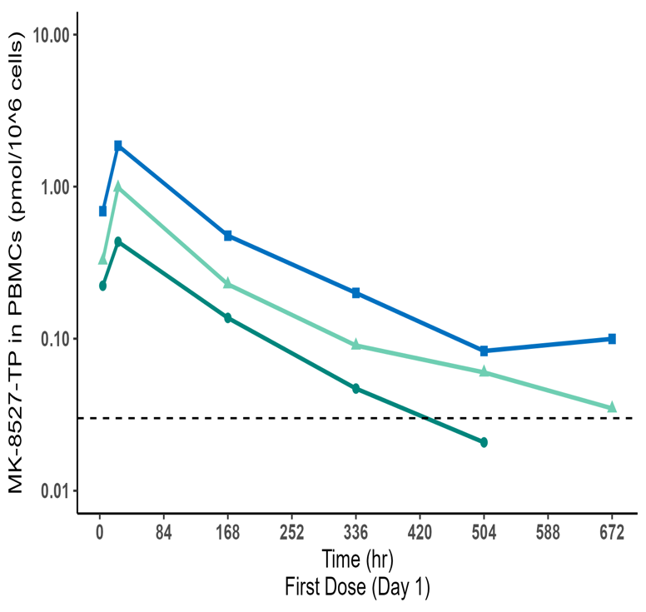
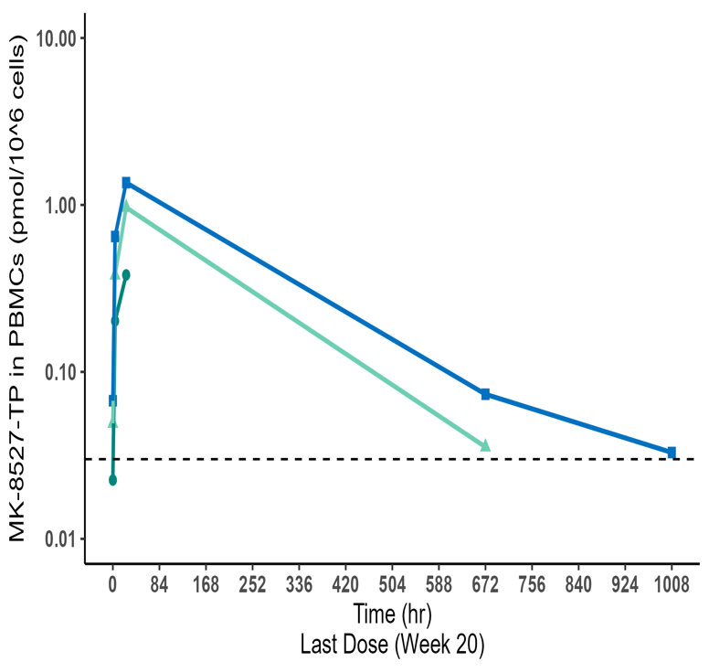
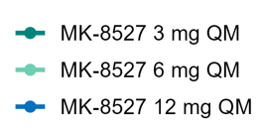
MK-8527-TP in PBMCs (PreP)
In this Phase 2 study conducted in adults with a low likelihood of HIV-1 exposure:
Six consecutive monthly doses of MK-8527 (3 mg, 6 mg, and 12 mg) were generally well tolerated.
The pharmacokinetics of MK-8527 and MK-8527-TP are dose-dependent.
These results support the clinical development of once-monthly oral MK-8527.
Phase 3 studies of once-monthly oral MK-8527, EXPrESSIVE-10 and EXPrESSIVE-11, are expected to begin in Q3 2025.
Concentration vs Time Profiles (semi-log scale)
PK Efficacy Threshold = 0.03 pmol/10^6 cells
PK parameters for MK-8527-TP are dose-proportional
Minimal accumulation of MK-8527-TP in PBMCs with monthly dosing
Notes:
The study showed that the pharmacokinetics of MK-8527 were clearly dose-proportional, and all these data do support further clinical development of this once-monthly oral PrEP candidate in phase 3 trials. These EXPreESSIVE studies are expected to begin vbefore the end of the year.
In this randomized, double-blind, placebo-controlled Phase 2 study conducted in adults with a low likelihood of HIV-1 exposure:
Six consecutive monthly doses of MK-8527 (3 mg, 6 mg, and 12 mg) were generally well tolerated.
The pharmacokinetics of MK-8527 and MK-8527-TP are dose-dependent.
These results support the clinical development of once-monthly oral MK-8527.
Phase 3 studies of once-monthly oral MK-8527, EXPrESSIVE-10 and EXPrESSIVE-11, are expected to begin in Q3 2025.
MK-8527 oral QM dose of ≥6 mg is expected to meet the therapeutic preventive threshold for PreP.
Dose selection for phase 3 was based on multiple factors that will be the subject of a future presentation.

Slide 16
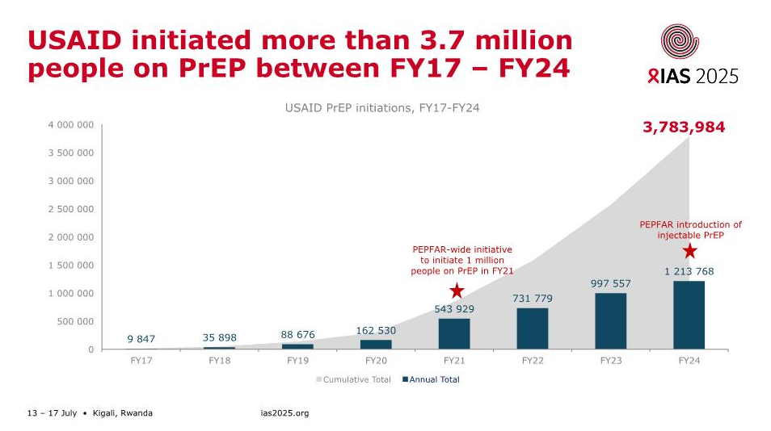
The challenge will be to sustain the global implementation of PrEP despite the withdrawal of U.S. funding
Kimmel et al (IAS2025); Presented by Anita Dam
Notes:
Finally, to complete the PrEP landscape, we must mention the end of U.S. humanitarian funding, which had enabled over 3.7 million people to initiate PrEP in the last five years. The current challenge will be to sustain this implementation despite the withdrawal of U.S. financial support.
All these innovations are taking place within a very particular ecosystem. It is worth recalling that USAID initiated more than 3.7 million people on PrEP between 2017 and 2024. The challenge we now face is to sustain global PrEP implementation despite the withdrawal of U.S. funding.

Slide 17
Take home messages: HIV Prevention and cure
Broadly neutralizing antibodies – featured in both the cure and prevention sections.
In the PURPOSE 1 and PURPOSE 2 studies, twice-yearly subcutaneous lenacapavir (LEN) was demonstrated to be effective and safe in a broad range of populations.
LEN PrEP is now included in the new WHO PrEP guidelines.
Once-monthly oral PrEP is emerging—driving prevention forward by offering individualized options.
The impact of budget cuts on the HIV epidemic was shown, in one modeling study, to be extensive, with community and prevention services being most affected.
The Global Fund and Gilead Sciences announced an access agreement that will see Gilead supplying doses, at no profit, for up to two million people over 3 years.
Notes:
Following FDA approval of LEN for HIV prevention, the Global Fund and Gilead Sciences announced an access agreement on the eve of IAS 2025 that will see Gilead supplying doses, at no profit, for up to two million people over three years. And WHO released guidelines recommending use of LEN as an additional choice in combination HIV prevention approaches.

Slide 18
HIV Vaccine in the Era of Twice-Yearly Lenacapavir PrEP: A Necessity or an Obsolete Option?
(Patt et al, New Eng J Med, April 24th, 2025)
Notes:
One might ask whether it’s still wise to pursue the seemingly endless quest for an HIV vaccine in an era where lenacapavir offers twice-yearly—and potentially once-yearly—pre-exposure prophylaxis. But that, in itself, could be the subject of an entire conference. But you might have an idea to answer this question?
With all these advances, some may wonder whether continuing HIV vaccine research is still necessary in the era of highly effective twice-yearly PrEP. I must emphasize here that it is certainly necessary to combine different options to achieve the elimination of HIV as a public health threat.
36. One might ask whether it’s still wise to pursue the seemingly endless quest for an HIV vaccine in an era where lenacapavir offers twice-yearly—and potentially once-yearly—pre-exposure prophylaxis. But that, in itself, could be the subject of an entire conference. But you might have an idea to answer this question?
Data shows that lenacapavir (LEN), injected twice yearly, is almost 100% effective in preventing HIV acquisition. Lenacapavir was the magic word at IAS 2025, with equitable access becoming more urgent amid the funding crisis. Following FDA approval of LEN for HIV prevention, the Global Fund and Gilead Sciences announced an access agreement on the eve of IAS 2025 that will see Gilead supplying doses, at no profit, for up to two million people over three years. And WHO released guidelines recommending use of LEN as an additional choice in combination HIV prevention approaches.

Slide 19
Should we continue pursuing vaccine research today?
Long-acting injectable PrEP involves multiple drug interactions (anticonvulsants, glucocorticoids, etc.).
Its protection is likely more durable.
Selection of the N74D resistance mutation at HIV diagnosis has been observed in cases of PrEP failure.
The vaccine likely has a broader and more lasting impact, reaching diverse populations.
The requirements are high, with a new twice-yearly injectable PrEP formulation.
Inclusion of patients in the era of PrEP?
New and even longer-acting formulations are in development (annual LEN).
It deserves a combined approach!
Notes:
La PreP nécessite un accès durable aux soins de santé

Slide 20
Content
From track A to track D: a personalized pathway!
Cure and Prevention – HIV in the corner
ART strategies
Co-morbidities
Guidelines and implementation science
Conclusions and Take-home messages
13 – 17 July • Kigali, Rwanda
ias2025.org

Slide 21



What’s new in WHO guidelines: advancing prevention, testing and treatment for impact and sustainability
SAT11:
New recommendations
HIV prevention and treatment
Management of advanced HIV Disease
Service delivery and integration
ias2025.org
Notes:
WHO’s updated recommendations on treatment and management of advanced HIV disease are of particular interest.
WHO recommendations on treatment and management of advanced HIV disease. Interestingly, WHO has updated its guidance to recommend darunavir as the preferred protease inhibitor. WHO also noted that either tenofovir disoproxil fumarate (TDF) or tenofovir alafenamide (TAF) should be used as preferred options, whether in initial therapy or in sequential therapy.
Although these molecules were already in use, this represents the introduction of the concept of “recycling” NRTIs into WHO recommendations. For children under 30 kg, abacavir is now the preferred option.
WHO also recognized two simplification strategies:
dual therapy with DTG + 3TC,
and intramuscular injectables cabotegravir + rilpivirine in adults and adolescents with undetectable viral load.
It is important to recognize again the significance of these recommendations. While injectable therapies are not yet widely available, WHO guidance will be a necessary — though not sufficient — condition for all people living with HIV worldwide to benefit from harmonized recommendations and highly effective treatments.

Slide 22
HIV guidelines New treatment recommendations
Treatment | Previous recommendations | New recommendations
Preferred and alternative PI options | ATV/r and LPV/r preferred PI options DRV/r as alternative PI option | DRV/r as preferred PI option
Preferred and alternative NRTI options | TDF as preferred option for ART initiation in adults and adolescents ABC as preferred NRTI option for ART initiation in children AZT or TAF as alternative options or used in special circumstances | Adults, adolescents and children > 30 kg: TDF or TAF as preferred option in initial and subsequent regimens (even if TDF or AZT previously used) Children < 30 kg: ABC as preferred option in initial regimens. ABC or TAF as preferred options in subsequent regimens (even if ABC or AZT previously used) DTG+3TC as ART simplification strategy in adults and adolescents with undetectable HIV viral load*
NRTI sequencing in subsequent regimens | AZT in subsequent regimen if TDF or ABC used in initial regimen (and vice versa)
Dual ARV oral regimens | ---
Long-acting injectable regimens | --- | CAB + RPV as alternative ART switching option in adults and adolescents with undetectable HIV viral load*
*no active HBV infection
The Medicines Patent Pool (MPP) and ViiV Healthcare announced a licensing agreement to allow generic production of CAB-LA for HIV treatment for use in combination with rilpivirine in 133 countries
Notes:
WHO now recommends darunavir as the preferred protease inhibitor.
Tenofovir disoproxil fumarate (TDF) or TAF are considered interchangeable preferred options in both first-line and sequential regimens, introducing the concept of “NRTI recycling.”
In children <30 kg, abacavir is now the preferred option. WHO also recognizes two simplification strategies: DTG+3TC dual therapy, and long-acting injectables (cabotegravir + rilpivirine) for adults and adolescents with suppressed viral load.
These recommendations are important—even where injectables are not yet available—since WHO guidance is a necessary (though not sufficient) condition to ensure alignment and access to highly effective therapies worldwide.
The Medicines Patent Pool (MPP) and ViiV Healthcare announced a licensing agreement to allow generic production of CAB-LA for HIV treatment for use in combination with rilpivirine in 133 countries, which MPP’s Esteban Burrone described as “a significant step forward for equitable access”.

Slide 23
Systematic review and meta-analysis of the efficacy of intermittent antiretroviral therapy dosing
Can intermittent therapy be a crisis response to the sudden cuts in USAID and PEPFAR funding?
Cassandra Fairhead et al , Royal Free Hospital, London
13 – 17 July • Kigali, Rwanda
ias2025.org
Notes:
However, addressing the financial crisis cannot rely on policy statements alone. London colleagues presented a systematic review and meta-analysis on the effectiveness of intermittent oral therapy (4 or 5 days per week), questioning whether this could help reduce costs

Slide 24
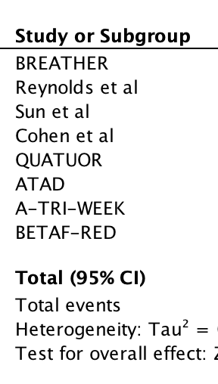
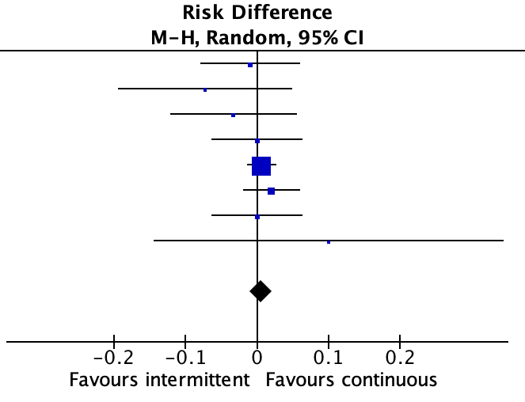
Efficacy (HIV RNA ≥50 copies/mL*), ITT analysis
Systematic review and meta-analysis of the efficacy of intermittent ART
Risk Difference 0.00
95%CI -0.01 to 0.02
p=0.54
13 – 17 July • Kigali, Rwanda
ias2025.org
*A-TRI-WEEK: 37 copies/ml; Cohen and Reynolds et al: 400 copies/mL
Notes:
This study showed that intermittent regimens (4 or 5 days out of 7) were comparable to daily treatment in terms of maintaining viral suppression (HIV RNA <50 copies/mL)

Slide 25
Short cycle ART with weekends off is inferior to continuous ART in adolescents living with HIV receiving TLD in sub-Saharan Africa:
BREATHER Plus 96-week results
Adeodata R. Kekitiinwa et al, on behalf of the BREATHER Plus trial team
Session: Co-Chair's choice
Abstract code: OAS0104LB
Notes:
However, these results were not confirmed in the BREATHER+ trial, whose 96-week results were also presented at the conference.
The BREATHER Plus trial in 12-19 year olds living with HIV on TLD saw inferior outcomes in virological rebound in those on short-cycle ART with weekends off ART versus continuous ART.

Slide 26
Primary efficacy endpoint: inferiority
NI margin
Primary analysis: 99% CI
5.1% (CI:-0.8, 11.5)
Primary analysis: 95% CI
5.1% (CI:0.5, 9.9)
Favours SCT ← 0 → Favours CT
4
6
8
10
Risk difference (SCT-CT, % with confirmed viral rebound)
Rate of confirmed virologic rebound by Wk 96 in SCT ART arm did not meet criteria for noninferiority to CT ART
SCT ART was inferior to CT ART (P = .034)
13 – 17 July • Kigali, Rwanda
ias2025.org
*2 consecutive plasma HIV-RNA ≥50 copies/mL
Notes:
This key slide shows the primary endpoint of the trial. The non-inferiority margin was not met, and at week 96, intermittent therapy was inferior to continuous therapy. Why is this important?
Rate of confirmed virologic rebound by Wk 96 in SCT ART arm did not meet criteria for noninferiority to CT ART
SCT ART was inferior to CT ART (P = .034)

Slide 27
Why is this important?
In times of funding constraints, intermittent therapy may be a strategy worth exploring; however, results across different settings and populations may not be directly generalizable.
13 – 17 July • Kigali, Rwanda
ias2025.org
Notes:
Intermittent therapy remains of interest, but current evidence is not yet sufficient to support strong recommendations

Slide 28
Long-acting cabotegravir and rilpivirine in adults with suboptimal HIV control in sub-Saharan Africa
The IMPALA trial 48-week results
Fiona Cresswell
on behalf of Eugene Ruzagira, Loice Achieng Ombajo, Nigel Garret, Noela Owarwo, Eva Laker Odongpiny, Henry Mugerwa, Ibrahim Yawe, Sheetal Kassim, Sharana Mahomed, Awhonukeh Idahosa, Ingrid Eshun-Wisonova and the IMPALA trial team
Does LA injectable ART can be effective in people with suboptimal control in high- and low and medium- income countries?
Co-Chairs’ choice, OAS01
Notes:
I also chose to present the IMPALA trial results (48 weeks), presented by Fiona Creswell’s team, which asked whether long-acting injectables could be effective in people with suboptimal viral control in resource-limited settings
Primary endpoint: proportion of participants with HIV-1 RNA <50 copies/mL at Wk 48 (FDA snapshot algorithm)
Key secondary endpoints: proportion of participants 1) with HIV-1 RNA ≥50 copies/mL (FDA snapshot),
2) with CVF (HIV-1 RNA ≥200 copies/mL on 2 consecutive occasions ~4 wk apart), 3) experiencing adverse events; participant-reported outcomes
Prespecified virologic failure sensitivity analysis: proportion of participants with CVF at 200 copies/mL or one HIV-1 RNA >1000 copies/mL
In addition to generating evidence from adults with sub-optimal HIV control in the public health, the IMPALA trial sought to generate more evidence for people with prior hepatitis B virus exposure and for women.

Slide 29
Study rationale and design
Evidence gaps: sub-optimal HIV control in public health approach, prior HBV exposure (cAb+), women
Phase 3b, open-label, non-inferiority trial
7 sites: Uganda, Kenya, S. Africa (NCT05546242)
Optional 1 month oral lead in
CAB LA + RPV LA
600 mg / 900mg
IM Q8W
4 years post-study access
Population, n=540
>18 y.o. with suboptimal HIV-1 control
SCREENING
PHASE
HIV-1 VL <200 c/ml for >3 months at the end of screening
2NRTI + DTG
HIV-1 VL >1000 c/ml in prior 2 yrs despite being on ART
History of loss to follow- up (>4 wks)
Unlinked to HIV care >3 months since HIV diagnosis
2NRTI + DTG
Transition to Standard of Care
Key exclusions:
Second-line ART
Pregnant or breastfeeding
Positive hepatitis B virus surface antigen
1:1
DTG = dolutegravir, CAB = cabotegravir, RPV = rilpivirine,
IM = intramuscular, Q8W = 8-weekly dosing
Day 1 12 months 24 months
13 – 17 July • Kigali, Rwanda
ias2025.org
Participants on the LA arm recevied their first injection at month 1
HIV1-VL is tested 4 times in year 1 and 2 times in year 2
Notes:
It is a 3b, open-label, non-inferiority trial with 7 sites in Uganda, Kenya and South Africa.
The participants had documented HIV VL >1000 despite being ART-experienced OR had been disengaged from care for > 4 weeks.
Those who were on second-line ART, pregnant or breastfeeding or had chronic hepatitis B were excluded.
After at least 3 months of viral suppression on tenofovir/lamivudine/dolutegravir (TLD), participants were randomised 1:1 to either receive 2-monthly cabotegravir / rilpivirine with an optional 1 month oral lead in, or to continue oral therapy.

Slide 30
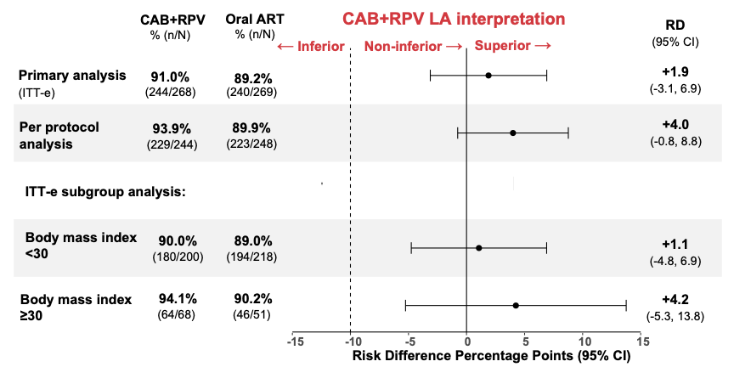
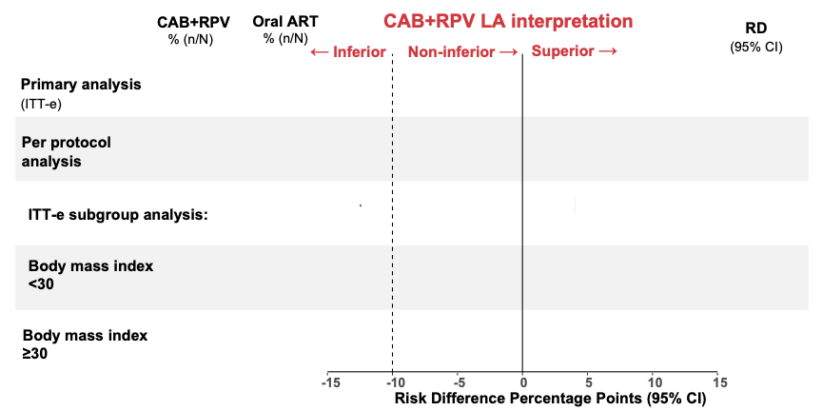
Primary outcome at Week 48
99.0% retention. 98% of 2159 injections given within window
HIV-1 VL <50 c/mL
demonstrating
non-inferiority
demonstrating
non-inferiority
13 – 17 July • Kigali, Rwanda
ias2025.org
Notes:
At week 48, the primary endpoint showed that cabotegravir + rilpivirine injections were non-inferior to daily oral therapy—even in patients whose viral load was uncontrolled at baseline.
At week 48 the study had a 99% retention, and 98% of injections were given within window.
91% of the participants on the LA arm and 89% in the oral arm remained virally suppressed, demonstrating non-inferiority.
In the per protocol population, 94% of participants on LA and 90% on orals remained virally suppressed, demonstrating non-inferiority.
Efficacy was not compromised in those with BMI > 30

Slide 31
Why is this important?
Long-acting injectable ART is effective in individuals with suboptimal viral control across high-, middle-, and low-income countries
13 – 17 July • Kigali, Rwanda
ias2025.org

Slide 32
Content
From track A to track D: a personalized pathway!
Cure and Prevention – HIV in the corner
ART strategies
Co-morbidities
Guidelines and implementation science
Conclusions and Take-home messages
13 – 17 July • Kigali, Rwanda
ias2025.org

Slide 33
Tecovirimat for mpox - primary clinical outcome results from the randomized part of the
Unity trial
B. Grinsztejn, I. C. Olsen, S. Haviari, P. Cahn, N. Daabek, , S. W. Cardoso, M. S. T. da Silva, E. Telford, R. Trefiglio, O. Segeral, V. G. Veloso, Y. Yazdanphanah, and A. Calmy for the Unity Study
A phase III, multi-country, randomized, placebo-controlled, double-blinded superiority trial to assess the efficacy and safety of tecovirimat antiviral treatment for patients with mpox virus disease in Argentina (2), Brazil (6), and Switzerland (2)
with the primary objective of assessing the time from randomization to resolution of all lesions
Notes:
Good morning and thank you very much for the opportunity to present, on the behalf of our team, the primary clinical outcome results from the randomized part of the UNITY clinical trial.

Slide 34


The Unity trial
Screening
Tecovirimat
14 days + SOC
N= 223
Adults or adolescents 14+
Mpox infection w one active lesion
Confirmed by PCR or highly suspected
No contraindication to study drug
Randomization
1:1
Placebo
14 days + SOC
N= 223
Severe complications
Severe immune suppression
Pregnant and breastfeeding women
Open-label arm
Tecovirimat
14 days + SOC
13 – 17 July • Kigali, Rwanda
ias2025.org
Notes:
Eligible participants were adolescents and adults (≥14 years) with confirmed or highly suspected mpox and at least one active lesion. Those without severe complications were randomized 1:1 to receive tecovirimat or placebo plus standard care for 14 days. Participants with severe complications, severe immunosuppression (e.g., HIV with CD4 <100), or pregnancy/breastfeeding were assigned to an open-label arm receiving tecovirimat and standard care.

Slide 35
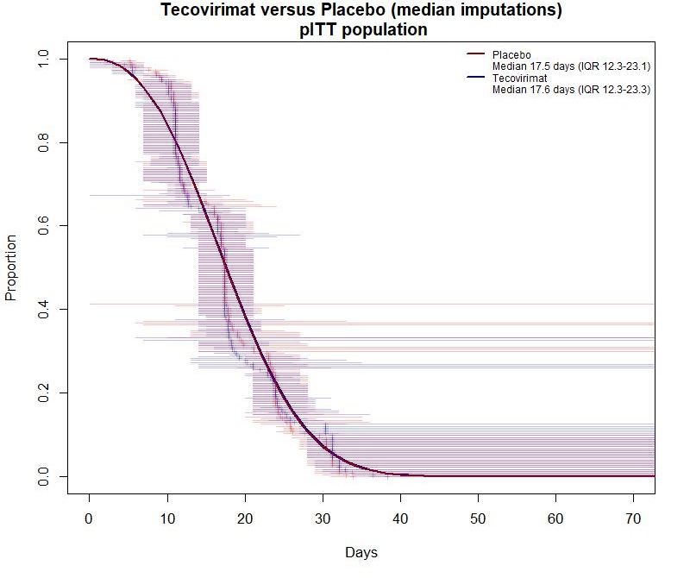
Primary endpoint:
Time to complete lesion resolution
Median age was 34 years
(With) 95% identifying as MSM
(And) about two-thirds as non-white
94% were enrolled in Brazil.
Time ratio = 1.02 (p=0.73)
13 – 17 July • Kigali, Rwanda
ias2025.org
Notes:
The primary outcome was measured by the percent decrease in time to complete clinical resolution of all skin or visible mucosal lesions, comparing participants prescribed tecovirimat to those who received no treatment. The analysis followed a treatment policy strategy based on the intention-to-treat principle and was conducted using Weibull regression, which accounts for interval-censored observations. Because we had resolution intervals and not precise dates, we used explicit modelling to derive the time to lesion resolution. The model was adjusted for plus or minus 7 days since symptom onset and for baseline complications.
What you see in the graph is the individual resolution windows, one line for each patient in each arm, and the curve shows the population behavior as estimated by the model. Unfortunately, there was no difference between the tecovirimat and placebo in the primary analysis, with virtually identical median time to complete lesion resolution between groups.

Slide 36
Conclusions of the Unity trial
The UNITY findings contribute to a growing body of evidence that tecovirimat is safe but not efficacious in leading to faster resolution of mpox lesions, even in a population with higher prevalence of HIV coinfection.
  Results are consistent with STOMP (Clade II) and with PALM-007 (Clade I mpox).
Ongoing work will evaluate the open-label arm, pharmacokinetic/pharmacodynamic, and virologic outcomes, including resistance
Individuals at higher risk for severe disease progression were not included in the randomized population.
There remains a critical need to identify effective therapeutic options for this population.
13 – 17 July • Kigali, Rwanda
ias2025.org
Notes:
In summary, the UNITY findings contribute to a growing body of evidence that tecovirimat is safe but not efficacious for mpox treatment, even in a population with higher prevalence of HIV coinfection.
These findings are consistent with results from both STOMP and PALM-007 trials. Further analyses of the open-label arm, PK/PD profiles, and virologic outcomes, including resistance, are ongoing. It is important to note that individuals at highest risk for severe disease progression were not included in the randomized population. Therefore, there remains a critical and urgent need to identify effective therapeutic options for those most vulnerable to mpox complications.
Les résultats de l’étude UNITY s’ajoutent aux données de plus en plus nombreuses indiquant que le tecovirimat présente un bon profil de sécurité, mais n’accélère pas la résolution des lésions liées au mpox, y compris dans une population avec une forte prévalence de co-infection par le VIH.
Ces résultats sont cohérents avec ceux des études STOMP (clade II) et PALM-007 (clade I mpox).
Des travaux sont en cours pour analyser la cohorte en ouvert, ainsi que les résultats pharmacocinétiques/pharmacodynamiques et virologiques, y compris en termes de résistance.
Les personnes à plus haut risque de progression sévère de la maladie n’étaient pas incluses dans la population randomisée.
Il demeure donc crucial d’identifier des options thérapeutiques efficaces pour cette population.

Slide 37
Conclusions of the Unity trial
The UNITY findings contribute to a growing body of evidence that tecovirimat is safe but not efficacious in leading to faster resolution of mpox lesions, even in a population with higher prevalence of HIV coinfection.
  Results are consistent with STOMP (Clade II) and with PALM-007 (Clade I mpox).
13 – 17 July • Kigali, Rwanda
ias2025.org
Notes:
In summary, the UNITY findings contribute to a growing body of evidence that tecovirimat is safe but not efficacious for mpox treatment, even in a population with higher prevalence of HIV coinfection.
These findings are consistent with results from both STOMP and PALM-007 trials. Further analyses of the open-label arm, PK/PD profiles, and virologic outcomes, including resistance, are ongoing. It is important to note that individuals at highest risk for severe disease progression were not included in the randomized population. Therefore, there remains a critical and urgent need to identify effective therapeutic options for those most vulnerable to mpox complications.
Les résultats de l’étude UNITY s’ajoutent aux données de plus en plus nombreuses indiquant que le tecovirimat présente un bon profil de sécurité, mais n’accélère pas la résolution des lésions liées au mpox, y compris dans une population avec une forte prévalence de co-infection par le VIH.
Ces résultats sont cohérents avec ceux des études STOMP (clade II) et PALM-007 (clade I mpox).
Des travaux sont en cours pour analyser la cohorte en ouvert, ainsi que les résultats pharmacocinétiques/pharmacodynamiques et virologiques, y compris en termes de résistance.
Les personnes à plus haut risque de progression sévère de la maladie n’étaient pas incluses dans la population randomisée.
Il demeure donc crucial d’identifier des options thérapeutiques efficaces pour cette population.

Slide 38
Promising Investigational Drugs & Strategies – Pot Pourri
HFR 10071 Phase IIa proof of concept study in treatment-naïve people with HIV of novel maturation inhibitor demonstrated a statistically significant reduction in HIV-1 RNA levels versus placebo over 14-day monotherapy period (Kumarasami et al)
Among 42 pregnancies with CAB exposure reported to the APR, most (39) were preconception exposures; 35 live births were reported with 1 birth defect (Vannappagari, Abstr OAB0402)
Phase II study of switching to once-weekly ISL + ULO vs continuing BIC/FTC/TAF supports further development with lower ISL dose (Molina et al Abstr OAB0102)
Notes:
I would now like to provide some brief updates from other important studies.
Vannappagari. IAS 2025. Abstr OAB0402.
In this analysis, 42 pregnancies with CAB exposure reported to the Antiretroviral Pregnancy Registry → 43 outcomes, including 35 live births (81.4%)
Most individuals (n = 39) were exposed to CAB preconception: 27 were exposed 0-6 mo prior to pregnancy, and 12 were exposed 6-12 mo prior (earliest exposure)
1 congenital defect (congenital ptosis) was reported among all live births
Among the 33 singleton, live births without defects, 5 were preterm, 3 had low birth weight, and 3 had very low birth weight
Investigators concluded that the findings reflect the positive safety profile of CAB, but the results should be interpreted with caution due to the limited number of pregnancies
Molina
Study halted after ~8 months with full enrollment due to decreases in total lymphocyte and CD4+ cell counts; development now continuing with reduced ISL dose (2 mg QW) and ULO 200 mg QW

Slide 39
Promising Investigational Drugs & Strategies – Pot Pourri (2)
ACTG A5391/DO-IT Trial in people with obesity showed that switching to DOR ± TDF vs continuing INSTI + TAF/FTC did not result in significant weight change at 48 weeks (Koethe et al, Abstr OAB0206LB)
In the TECAIN study, use of trichloroacetic acid for treatment of AIN in people with HIV provided comparable efficacy to the standard-of-care treatment, electrocautery (Esser et al, Abstr OAB0203)
Notes:
TCA was noninferior to ECA at post-treatment Week 24 in the ITT population but did not meet criteria for noninferiority at post-treatment Week 4 (the primary endpoint) Koethe. IAS 2025. Abstr OAB0206LB.
Primary outcome: Weight change at 48 weeks
Study 80% powered to detect 5% treatment difference between arms (DOR vs INSTI) (N = 150)
Other strategies are required to reduce weight gain and associated complications in people with obesity and HIV
Esser. IAS 2025. Abstr OAB0203.

Slide 40
Content
From track A to track D: a personalized pathway!
Cure and Prevention – HIV in the corner
ART strategies
Co-morbidities
Conclusions and Take-home messages
13 – 17 July • Kigali, Rwanda
ias2025.org

Slide 41
Key Messages – track A
HIV reservoir is complex – a roadmap for the development of cure interventions
  Immunotherapy, gene therapy, virus specific-targets, host genetics enable
HIV vaccines are necessary – both for prevention and cure
  The vaccine likely has a broader and more lasting impact, reaching diverse populations
  Innovative, combination, rapid pre-clinical and clinical studies for globe are essential.
HIV viral biology is being elucidated – better understanding of HIV virology enables new approaches
  MX2, TIP, excision strategies, CAR-T cells, enhanced bnAbs are in development
Challenges are substantial, but our knowledge and toolkits are expanding, and the future holds opportunities for the global scientific community to seize.
13 – 17 July • Kigali, Rwanda
ias2025.org
Notes:
Le réservoir du VIH est complexe – une feuille de route pour le développement d’interventions curatives
Immunothérapie, thérapie génique, cibles virales spécifiques et génétique de l’hôte ouvrent de nouvelles perspectives.
Les vaccins contre le VIH sont indispensables – tant pour la prévention que pour la guérison.
Le vaccin est probablement l’outil ayant l’impact le plus large et le plus durable, capable de toucher des populations diverses.
Des études innovantes, combinées, rapides, précliniques et cliniques, à l’échelle mondiale, sont essentielles.
La biologie du VIH est de mieux en mieux comprise – une connaissance approfondie de la virologie du VIH rend possibles de nouvelles approches.
Les stratégies basées sur MX2, TIP, l’excision, les cellules CAR-T et les anticorps neutralisants à large spectre (bnAbs) optimisés sont en cours de développement.
Les défis restent considérables, mais nos connaissances et nos outils progressent, et l’avenir recèle de véritables opportunités que la communauté scientifique mondiale peut saisir.

Slide 42
Key Messages – track B
Relevant studies have been presented, with a strong emphasis on long-acting ART—both injectable and oral—as well as on the use of two-drug combinations and intermittent ART in low- and middle-income countries.
Some of these strategies have been incorporated into guidelines, such as the WHO's recommendation of long-acting CAB-RPV for suppressed individuals, or DTG-3TC for treatment simplification
Although funding constraints have been a recurring theme throughout the conference, the key message we must take away is…we will not go back.
13 – 17 July • Kigali, Rwanda
ias2025.org
Notes:
« Des études pertinentes ont été présentées, avec un fort accent sur les traitements antirétroviraux à longue durée d’action—injectables ou oraux—ainsi que sur l’utilisation de combinaisons à deux médicaments et de traitements intermittents dans les pays à revenu faible et intermédiaire.
Certaines de ces stratégies ont été intégrées dans les recommandations, telles que la recommandation de l’OMS d’utiliser le CAB-RPV à longue durée d’action pour les personnes virémique suppressives, ou le DTG-3TC pour la simplification du traitement.
Bien que les contraintes de financement aient été un thème récurrent tout au long de la conférence, le message clé à retenir est – nous ne reviendrons pas en arrière

Slide 43
The Critical Role of Funding and Political Will for Prevention - Track C report
Political commitments—through sustained funding, alignment with PrEP preferences, and the elimination of stigma and discrimination—are key to driving PrEP uptake and advancing HIV prevention.
We must, and will, move forward without turning back
Notes:
Les engagements politiques—via un financement durable, l’adaptation aux préférences en matière de PrEP et l’élimination du stigma et de la discrimination—sont essentiels pour favoriser l’adoption de la PrEP et faire progresser la prévention du VIH.
Nous devons avancer, et nous avancerons, sans jamais revenir en arrière

Slide 44
General Context – Track D
Addressing social determinants of health is essential in HIV management because they directly impact individuals’ risk of infection, access to services, and treatment outcomes.
Notes:
Prendre en compte les déterminants sociaux de la santé est essentiel dans la prise en charge du VIH, car ils influencent directement le risque d’infection, l’accès aux services et les résultats du traitement.

Slide 45
Acknowledgements
Juan Ambrosioni
Justyna Gaczorek
Julia Vanian
Thanks to all of you for your attention!
13 – 17 July • Kigali, Rwanda
ias2025.org

